Slide 1


Welcome Parents!!
Grab a packet at the door.
Tell me about your child.
Choose any seat.
See me if you forgot your child’s schedule.
Social Studies Rocks!!!

Slide 2
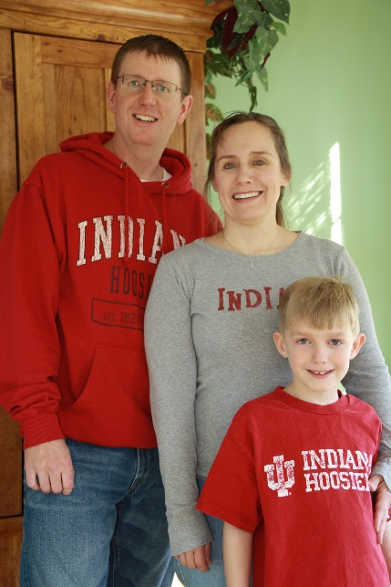
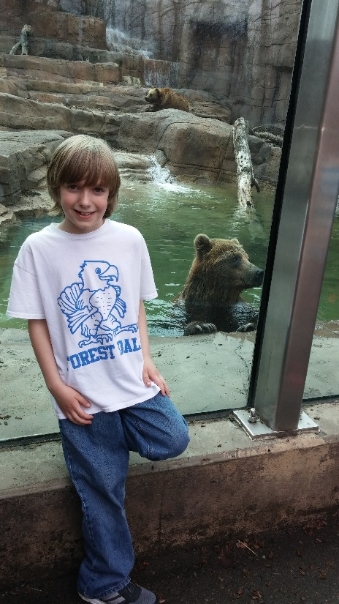
Cheri Boudouris
classroom 511
Subject: Social Studies
HIGH SCHOOL:
Jimtown High School, Elkhart IN
College:
Indiana University
Triple Major in Journalism, Education, and English
Added Social Studies to license in 2012
TEACHING EXPERIENCE:
12 years at Sheridan High School teaching ELA and Journalism
1 year Carmel Middle School - Humanities
2 years Creekside Middle School – Humanities
2nd year – Social Studies
PERSONAL:
Husband: Marc (Fitness Director at Five Seasons)
Son: Noah (4th grader at Forest Dale Elementary)
email: cboudour@ccs.k12.in.us
Phone ext: 6104

Slide 3


Social Studies
What will we be studying?
6th grade = Western World
7th grade = Eastern World
8th grade = US history

Slide 4

What will we be learning?
Geography
Economics
Culture
Government
History
South America
Central America and the Caribbean
Mexico
Canada
Ancient Greece and Rome
Middle Ages
Renaissance
Age of Exploration
Modern Europe
Novels

Slide 5


Daily Routine
1-- Students will check the “Social Studies: I Need…” POSTER to see what materials are needed for class.
2—Students follow the Daily Routine
- Fill out Assignment Notebook, initialed by a leader
- Begin Warm-up which is located on the front screen
3—Review warm-up, begin main activities
4—Last two minutes, reset room

Slide 6

BYOD for Social Studies
(Bring Your Own Device)
Personal devices are NOT required, but are allowed in my room.
We will occasionally use them for a quick research question.
If we ever have a longer assignment that requires the internet, we will use a computer lab or laptop cart.
If you have not signed and returned the BYOD permission slip, please do so. Return those to Ms. Gray (ELA).

Slide 7
AFTER SCHOOL STUDY HALL
After School Study Hall …
After School Study Hall runs Monday through Thursdays except when there is a school holiday the next day.
Students report to the media center and are divided into 2 groups. Desk workers go to a classroom and computer workers go to a lab.
Three staff members monitor. They assist and will help as needed. It is not tutoring.
The areas are meant to be quiet and controlled. No group work unless a teacher writes a pass for a short term project.
There is no advance sign up required; there is no charge.
All students need to be picked up by car or take the late bus after 4PM.
Discipline logs are kept. Three strikes and you are out--timeline to be determined by the administration.

Slide 8

What is this crazy class called Core+?
Core+ is a flexible block that the team of Marlin teachers can use for whatever we feel is needed. That might include:
Large group meetings with administrators or guidance
ISTEP and NWEA
Extended time for individual subjects
Group projects
Make-up tests
Remediation
Team parties or social activities
occasionally Learning Tables (subject specific homework time).
It is almost never the same thing twice.

Slide 9

CONTACT INFORMATION:
* We are transitioning over to the Learning Management System called “Canvas” and my homework page is located there. Your student can access that through the Creekside Webpage.
* At the Creekside page you can also find our Team Marlins page
My email is in the staff directory or on the front cover of the packet
cboudour@ccs.k12.in.us
317-733-6420, ext 6104

